Slide 1
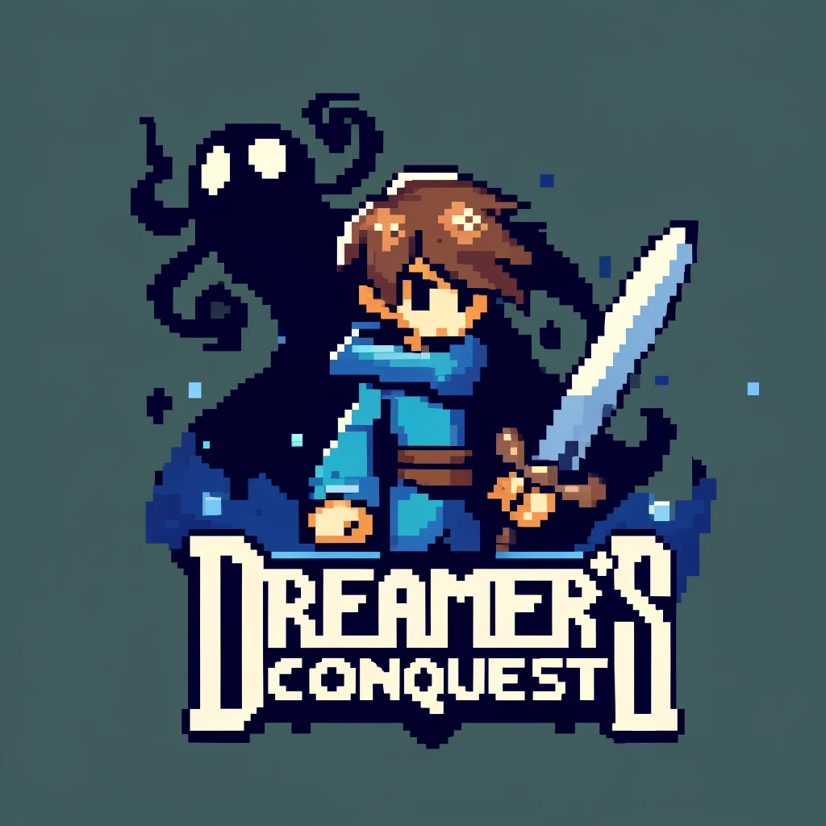
Videogame by Adilet Sooronbaev, Artyjom Csarkovszkij and Mean Diamand

Slide 2

Introduction
'Dreamer's Conquest' is an engaging 2D pixel art adventure that invites players into a richly woven narrative of mystery and power.
Set in a fantastical world, the game combines classic top-down exploration with vibrant storytelling.

Slide 3

Gameplay
In 'Dreamer's Conquest', players navigate through multiple levels, each presenting challenges and environments.
As Seong, the protagonist, players will confront various enemies in his quest.
Comment: Here the background could probably be from the game, or we could add some images presenting how the game looks.

Slide 4
Features at a glance
Multi-level Challenges: Each level presents different environment and set of monsters the player must kill.
Customization and Growth: Player can equip various armor sets and weapons to suit his playstyle.
Healing Mechanisms: Utilize potions to heal and sustain Seong through his trials.
Game Audio: A soundtrack that enhances the atmospheric depth of the game world.
Save Feature: Progress through the challenging world of 'Dreamer's Conquest' with the ability to save your game, ensuring that no adventure is lost.

Slide 5
Enemies
In our game we presented a player with challenges in the form of various enemies, which include Orcs, Goblins and a Skeletons.
Each enemy has its own characteristic like, for example, Orc deals greater challenge to a player, but he is slower than a Goblin and a Skeleton can shoot arrows at a player.
Enemies located at random places on the levels and the player must kill them all in order to progress further in the story.

Slide 6
Video of enemies
On this slide we could present a montage of the enemies and how they attack a player.

Slide 7
Inventory
Player can of course defend himself by attacking the enemies first.
Each level presents a player with some loot which can be picked up from the ground or looted from the killed enemies.
Each loot represents either a piece of armor to increase durability of a plyer, a weapon like sword to deal greater damage to enemies and a potions to restore health.
In order to equip an item player should open his inventory put the item into corresponding slot.

Slide 8
Video demo of inventory
Here we could show in a video montage how the inventory works.

Slide 9
Combat
Player can utilize weapons he finds during the game to kill the enemies.
Each weapon deals different damage.
Player can also use shields to block incoming enemy attacks.

Slide 10
Video demo of a combat
Here we could present a video demo of how player attacks and shields from enemies.

Slide 11
Levels and cutscenes
The game has 3 levels.
Each level presents different environment.
Each player contains various monsters.
Player can transition between levels if he kills all the enemies.
Each transition is accompanied with a small cutscene
Comments: We also could show the levels and transitions in the video demo

Slide 12
UI
Our game has a simple User Interface.
When player is killed, he is presented with game over screen and the player can choose to either restart from the last checkpoint or quit the game.
Player can also pause the game to save it or navigate back to the main menu.
When player opens inventory, he is also presented with inventory interface.
Comment: For IU we can present some screenshots of how it looks

Slide 13
Soundtrack
Our game uses non copyrighted soundtrack as a background music.
There are also sound effects for when the player is hitting and shooting the bow.
When the game is over for, there will also be the game over sound effect.
All of these sounds can be adjust in the volume setting.
Comment: Might show a video demo of the soundtrack in the game.

Slide 14
Save progress
During the game a player might want to save the game to keep all the progress.
When a player is killed or quits a game he might restart from the latest save he made.

Slide 15
Save progress video demo
Here we can present a video demo of save feature.

Slide 16
Tech stack
For the development of our game, we chose the Unity game engine, which provided a robust platform for creating immersive experiences.
The game's programming was carried out in C#.
To facilitate collaboration and version control, we utilized GitHub to manage our source code effectively, ensuring seamless teamwork throughout the project.

Slide 17
Resources used
The sprite sheets of the characters, textures of the maps and objects, and soundtracks integrated into our game were sourced from publicly available collections on the internet, ensuring that all materials used are freely accessible and suitable for our development needs.

Slide 18
Thank you for you time!

